Slide 1
Data Insights

Slide 2
Table of Contents
Generally elevated PM10
PM10 Events in December 2024
PM1 and PM2.5 come from different sources compared to PM10

Slide 3
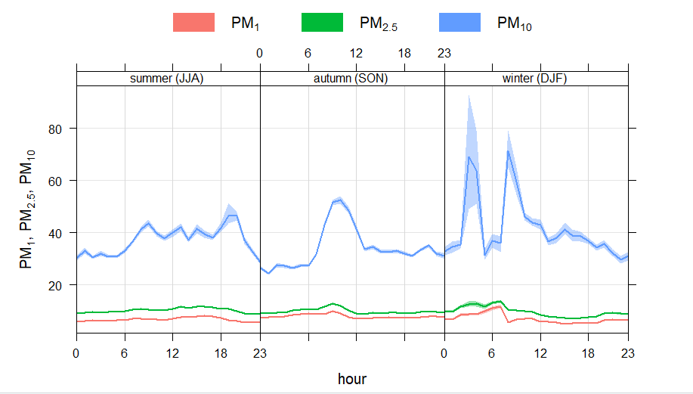
Generally elevated PM10

Slide 4
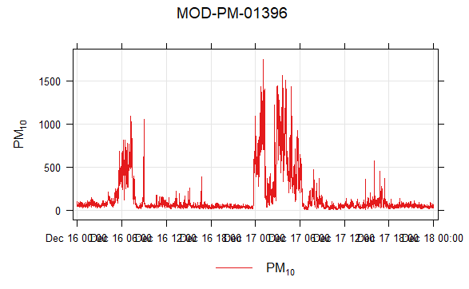
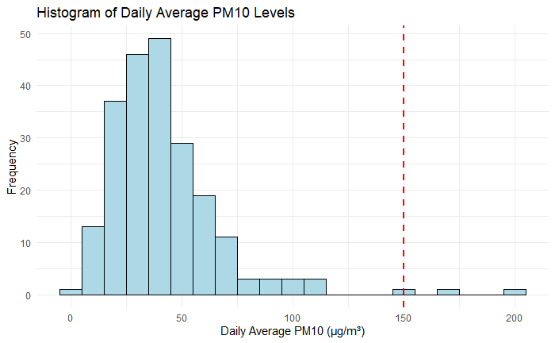
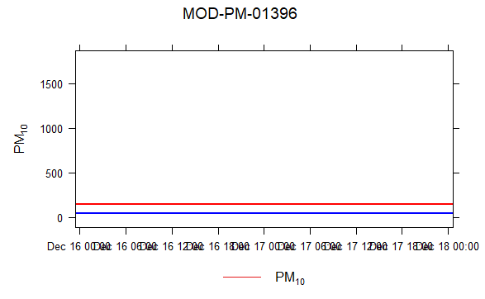
PM10 Events in December 2024
7/31* 12/17 12/18
In December 2024, we observed distinct PM10 events with levels often exceeding the EPA 24-hour limit of 150 µg/m³. The time series graph clearly shows sharp spikes—most notably on December 17 and 18—where PM10 levels far surpassed this standard.
Blue line - EPA PM 10 Limit
Red line - Average levels without 12/16-12/18 Dat
Notes:
7/31 - 145.1641 not above but close
Maybe add directionality from these dates
“EPA is retaining the existing primary 24-hour standard for coarse particles at 150 µg/m3. An area meets the 24-hour PM10 standard if it does not exceed the 150 µg/m3 level more than once per year on average over a three-year period.”

Slide 5
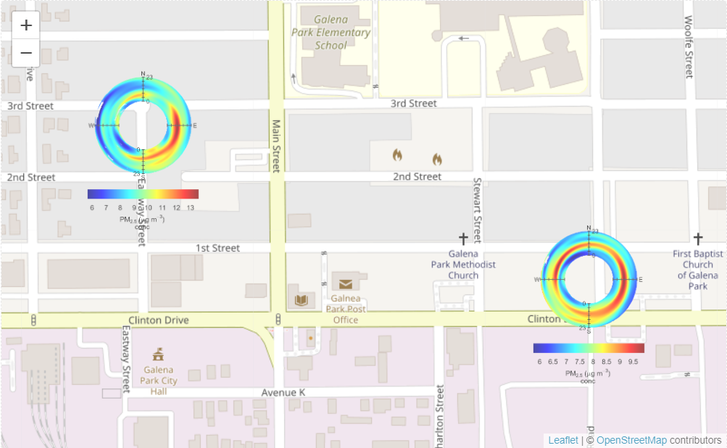
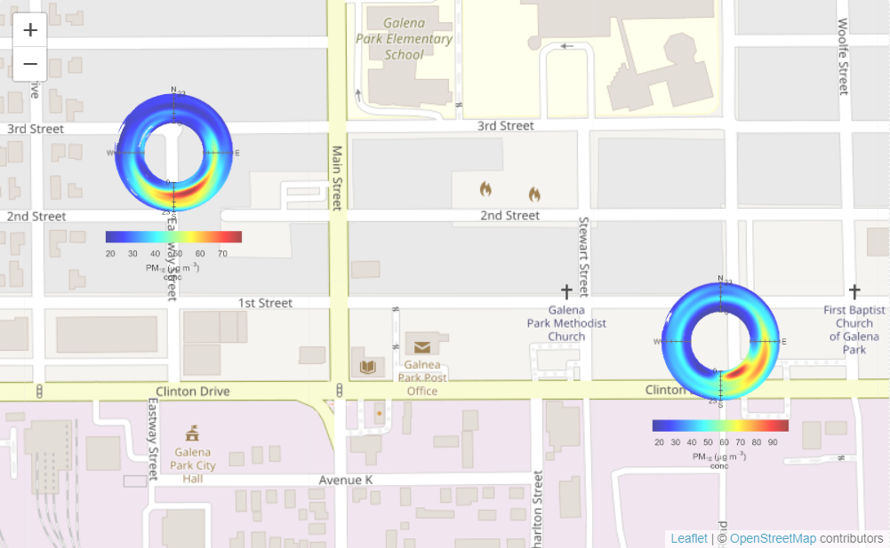
PM 1 & PM 2.5 are coming from different sources
PM 10 tends to come only from the south east, while PM 1 & PM 2.5 come from different places
PM 2.5
V.S
PM 10

Slide 6
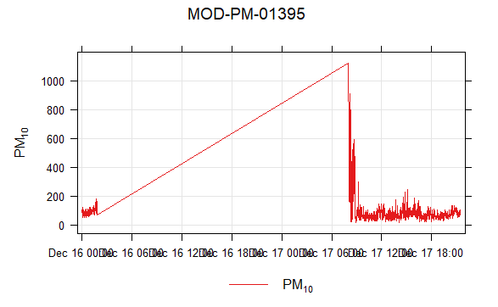
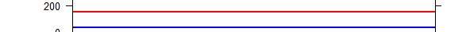
PM10 Events in December 2024
Blue line - EPA PM 10 Limit
Red line - Average levels without 12/16-12/18 Dat
“EPA is retaining the existing primary 24-hour standard for coarse particles at 150 µg/m3. An area meets the 24-hour PM10 standard if it does not exceed the 150 µg/m3 level more than once per year on average over a three-year period.”
7/31* 12/17 12/18
Notes:
7/31 - 145.1641 not above but close

Slide 7
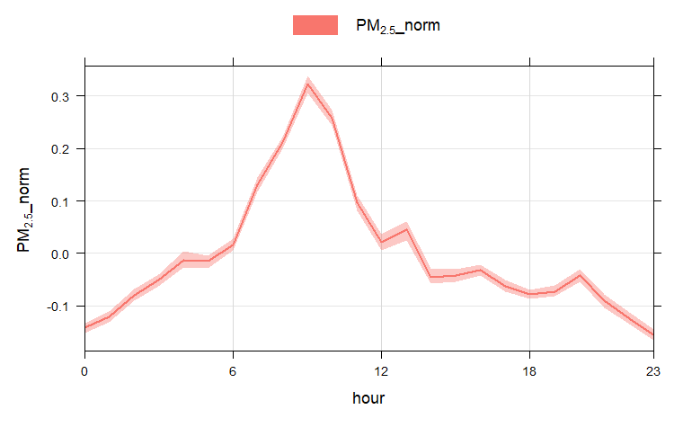
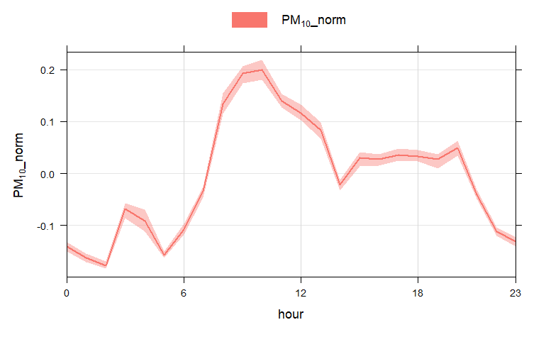
PM 10 stays high, despite PM 2.5 dropping off significantly after 12:00pm

Slide 8
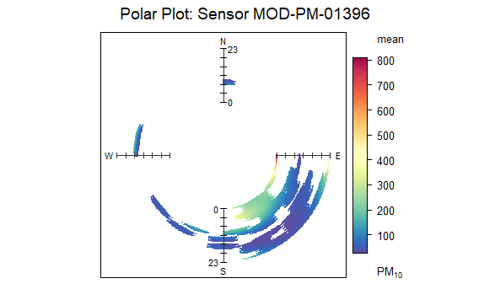
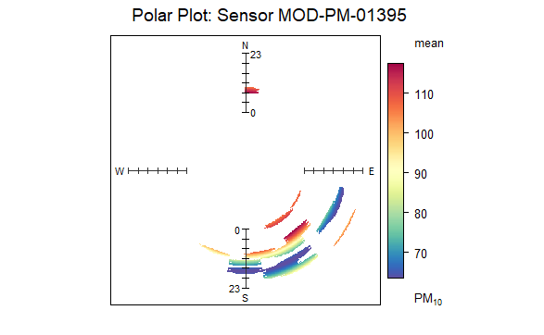
Polar Plots 12/16-12/18

Slide 9
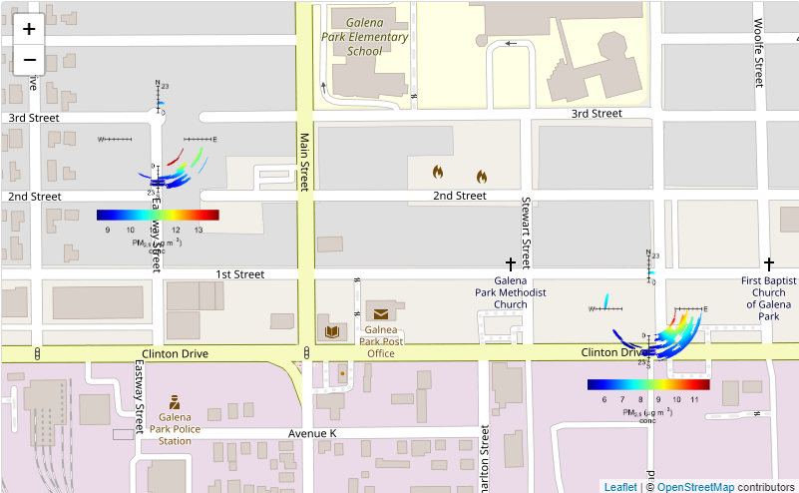
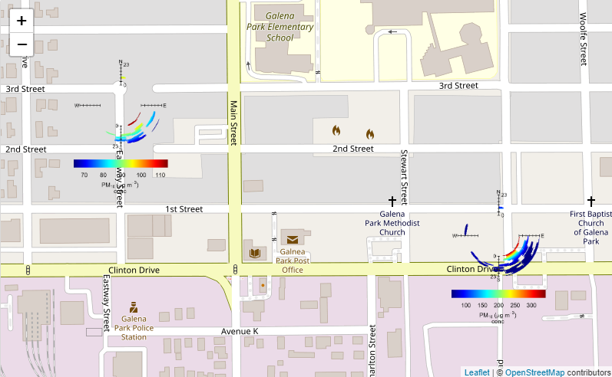
annulusMap 12/16 - 12/18
PM 2.5
PM 10

Slide 10
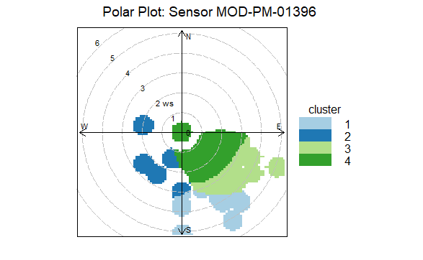
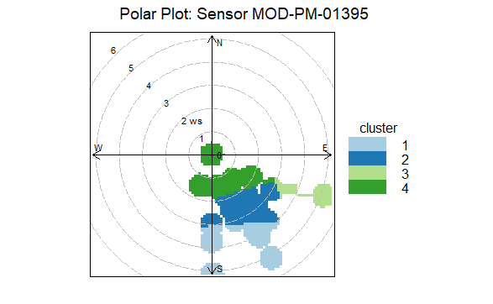
Polar Plots 12/16-12/18
Notes:
Starter with time series - first pass at analysis - diurnal profile; be explicit what it answers
Cal plot

Slide 11
Generally elevated PM10
Diurnal by seasons
  DoW hour
  Boxplot?
  Directionality
  Location on a the map of each sensor
Table w sensor

Slide 13
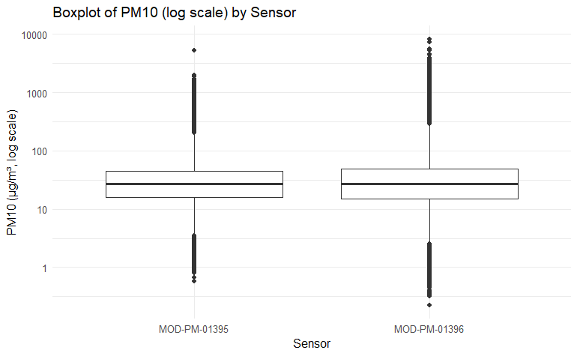
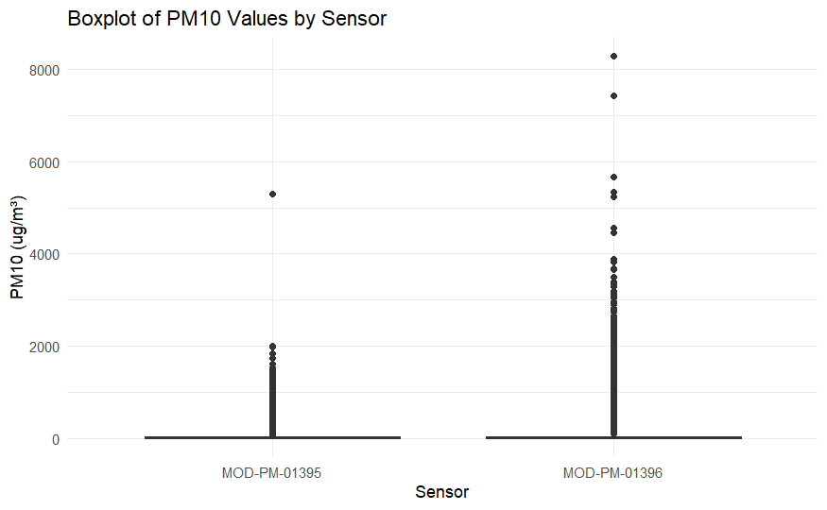
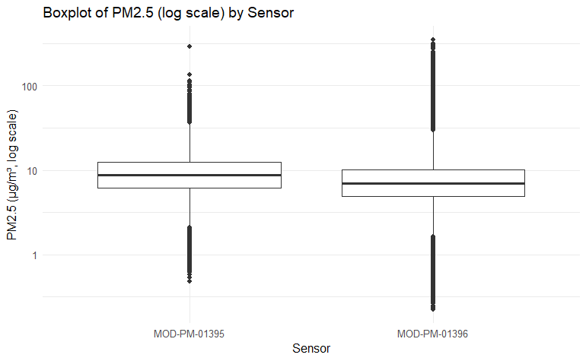
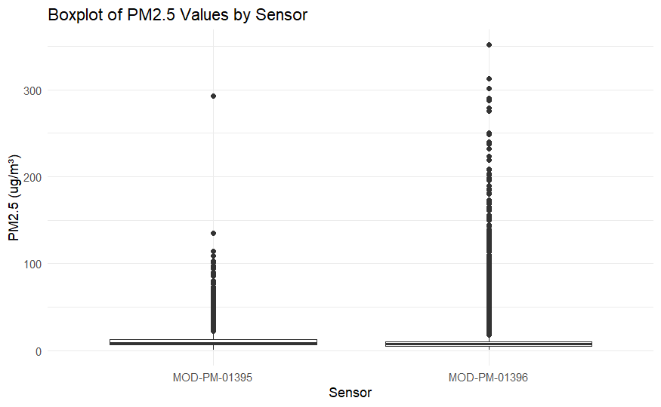

Slide 14
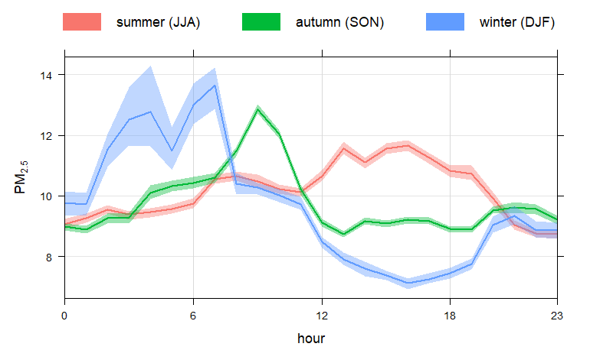
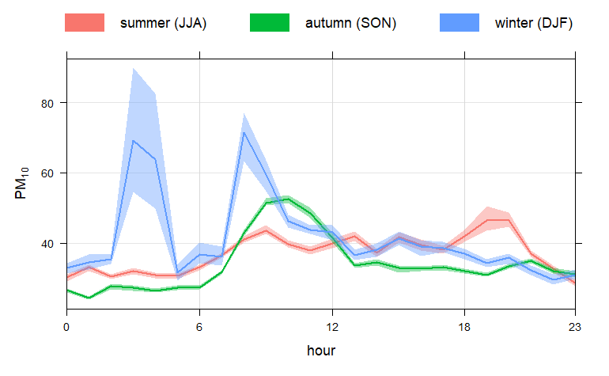
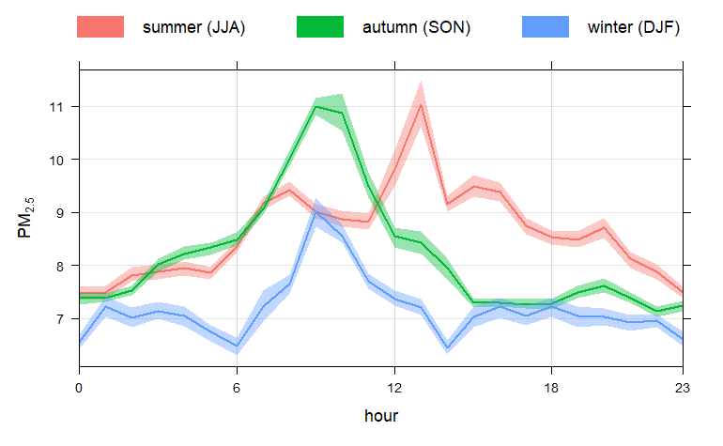
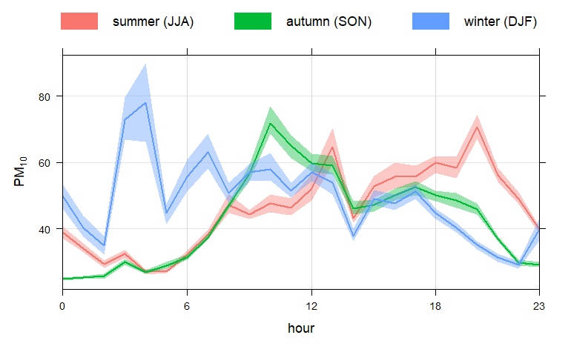
1395
1396

Slide 15
PM1 and PM2.5 come from different sources compared to PM10
Magnitude (mean +- SD)
Sources?
  Found through annulus plots of each pm level for each sensor
Diurnals
  Normalize the values and see if the trend reach peaks and min at the same times;
  Also do it for each sensor to see if they are applicable

Slide 16
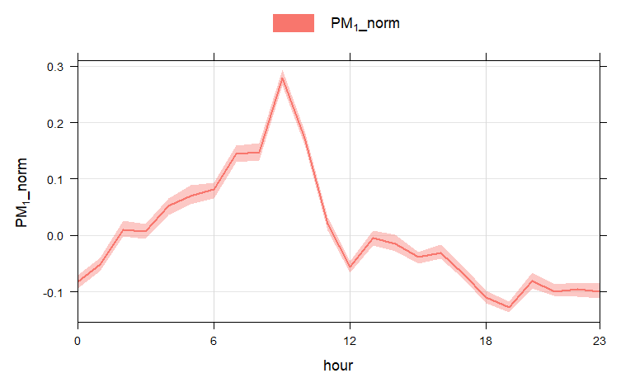

Slide 19
